Slide 1


Salvador Galán Brenes
Jose María Martín Martinez
Antonio Gómez Garcerán
Code Smells

Slide 2
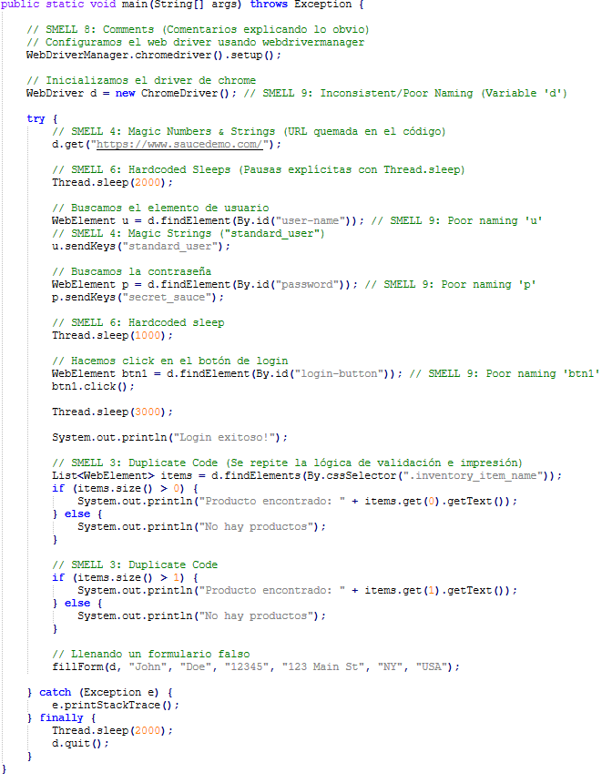
Bloaters
1.Long Method
2.Large Class
5.Long Parameter List
-All the code is in 1 class

Slide 3

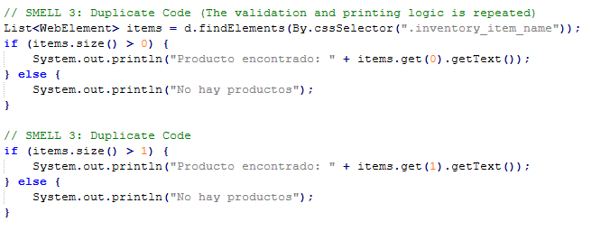

Dispensables
3.Duplicate Code
7.Dead Code
8.Obvious Comments

Slide 4
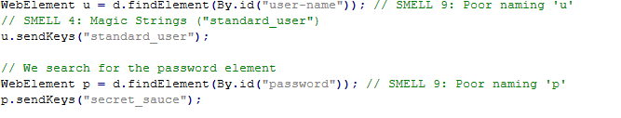
Obfuscators and Test Automation Smells
4.Magic Numbers and Strings
6.Hardcoded Sleeps
9.Inconsistent/Poor Naming

Slide 5
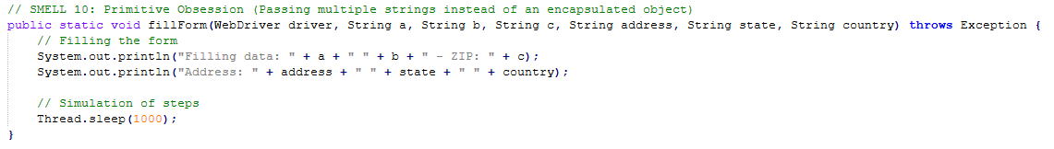
Object-Orientation Abusers
10.Primitive Obsession

Slide 6
Solutions

Slide 7
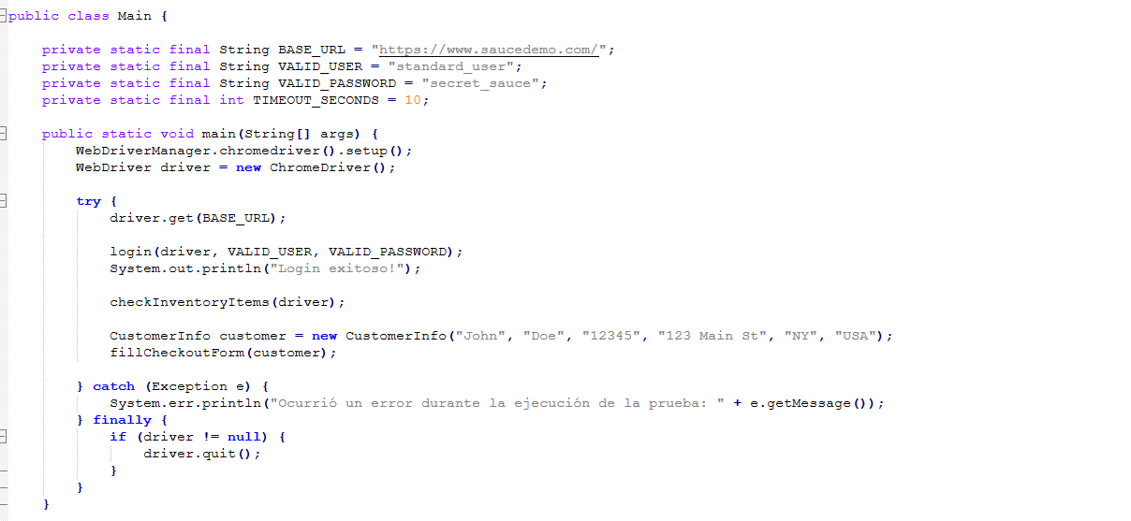
Extract Method and class

Slide 8
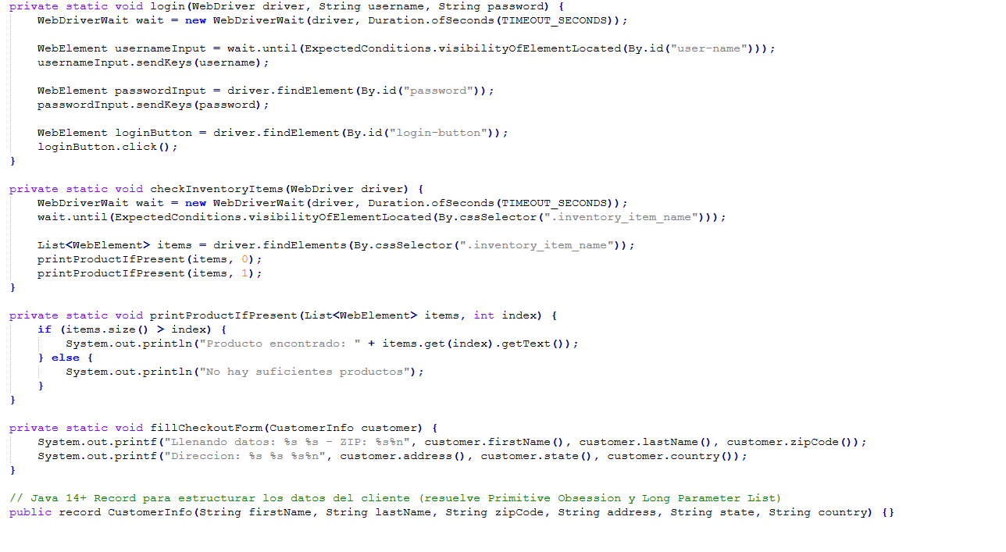

Slide 9
We will break down the main into smaller pieces of code to solve the Long Method and Large Class.

Slide 10
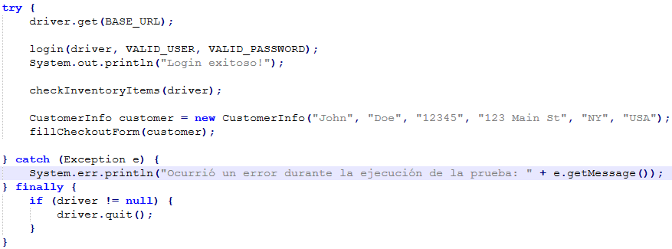
Introduce Parameter Object

Slide 11
We will create a class to handle the form data, solving the Long Parameter List and Primitive Obsession.

Slide 12
Extract Variables/Constants
We will move hardcoded URLs to solve Magic Numbers and Strings.

Slide 13

Rename Variables
We give the variables descriptive names fixing Inconsistent/Poor Naming

Slide 14
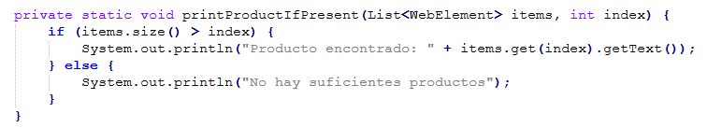
Remove Dispensables
We will delete Dead Code and Obvious Comments, then we extract the Duplicate Codes into reusable methods.

Slide 15
Implement Explicits Waits
We will replace Hardcoded Sleeps with the mechanisms of WebDriverWait

